Slide 1

AIRFLY INSIGHTS Airline Delay and Cancellation Analysis Submitted as part of Internship Project at Infosys
Presented by: Sankavi I

Slide 2

PROJECT OVERVIEW
• Analyze airline delays and cancellations • Identify patterns and key causes • Study seasonal impact (winter) • Understand factors affecting flight performance

Slide 3
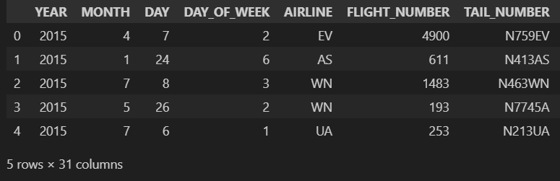
DATASET OVERVIEW
Large airline dataset (2015 flights data)
Contains millions of flight records
• Dataset contains ~580,000 flight records • Includes 30+ features • Contains airline, airport, delay, and cancellation details

Slide 4
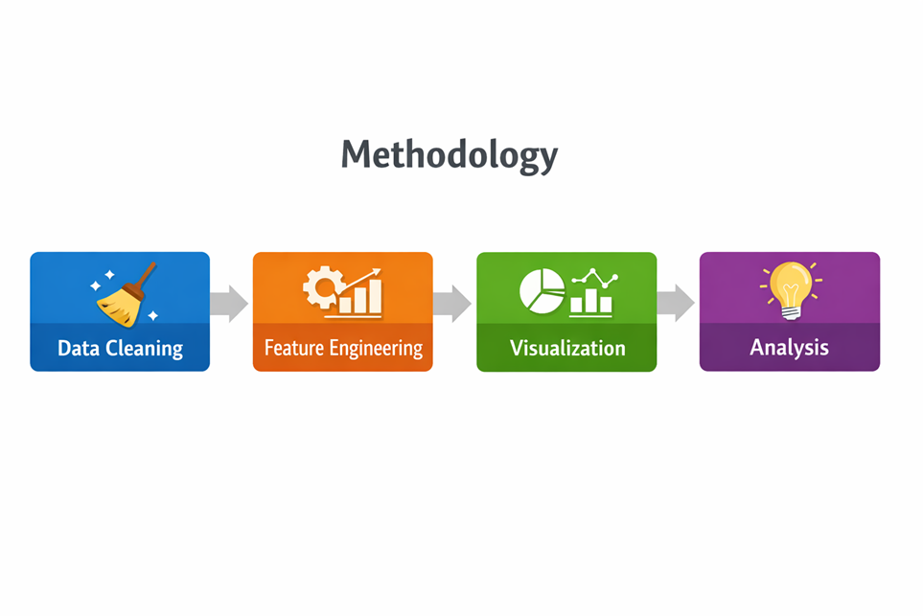

Slide 5
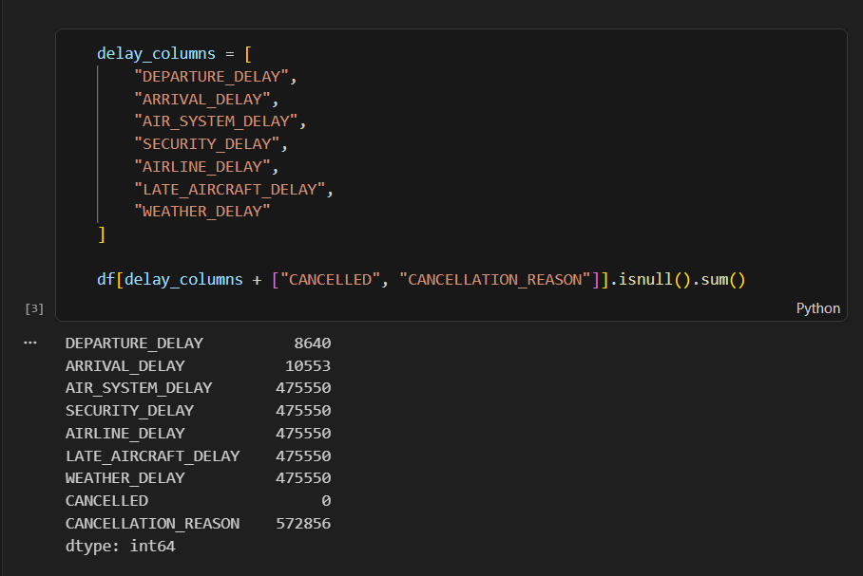
Data Preprocessing
Handled missing values
Cleaned delay-related columns
Removed inconsistent data
Formatted date and time columns

Slide 6
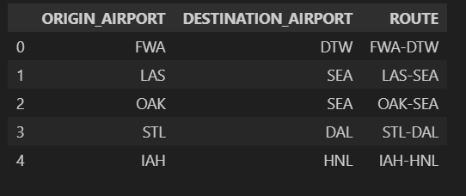
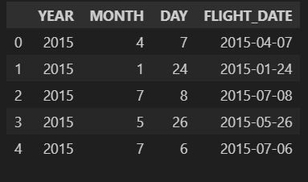
Feature Engineering
Created new features to enhance analysis:
Month
Day of Week
Hour
Route (Origin → Destination)
After Feature Engineering Size of the dataset became
• Created new features: Month, Day of Week, Hour, Route • Enhanced dataset for better analysis • Improved understanding of trends and patterns

Slide 7
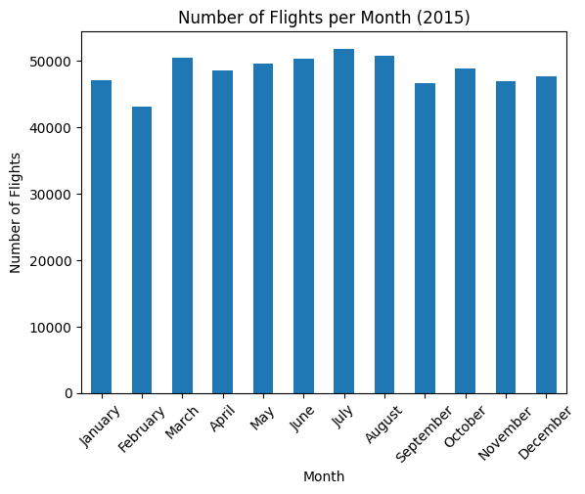
Flight Distribution
Flights vary across different months
Some months have higher air traffic
Indicates seasonal travel patterns

Slide 8
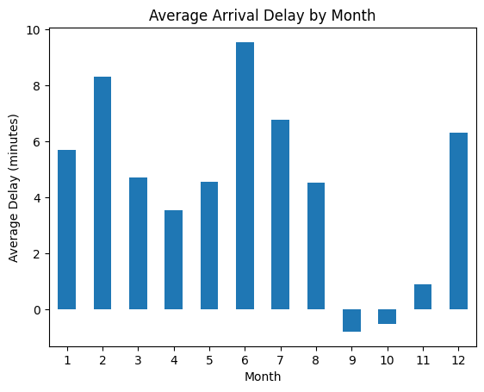
Delay Analysis
Delays vary across different months
Some months show higher average delays
Negative delay indicates early arrivals

Slide 9
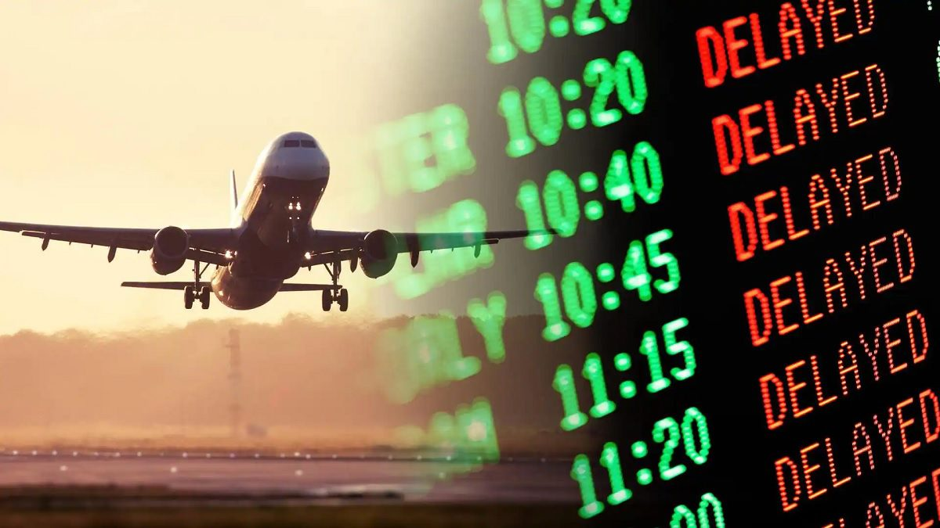
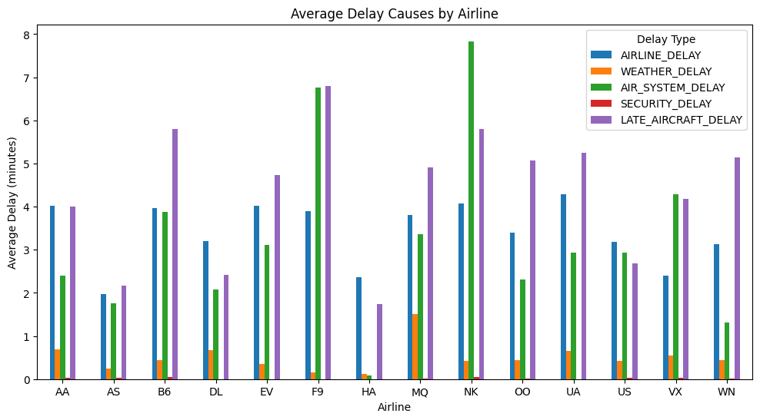
Delay by Airline
Delay performance varies across airlines
Some airlines experience higher delays
Indicates operational efficiency differences

Slide 10

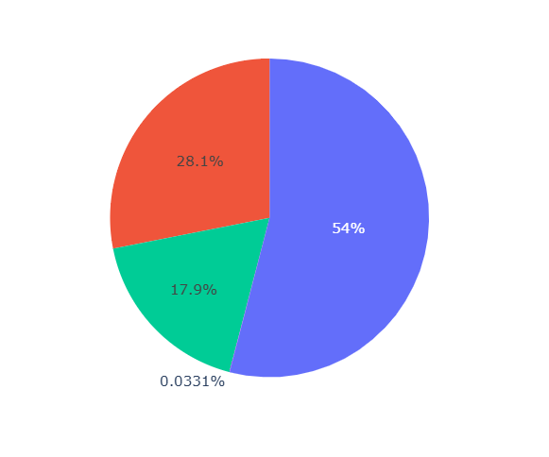
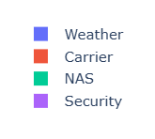
Cancellation Analysis
Flights are cancelled due to multiple reasons:
Weather
Carrier issues
NAS (Air Traffic System)
Security
Weather is a major factor in cancellations

Slide 11
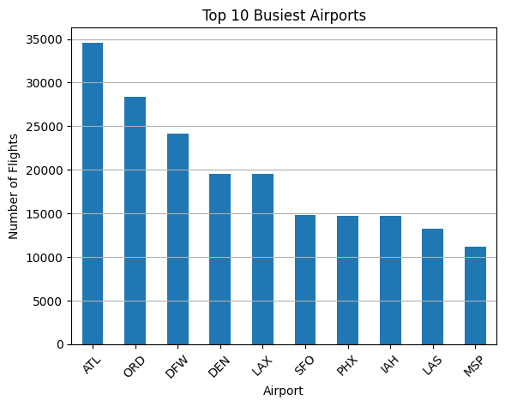
Airport Analysis
Some airports handle very high traffic
Busy airports tend to experience more delays
Traffic congestion impacts performance

Slide 12
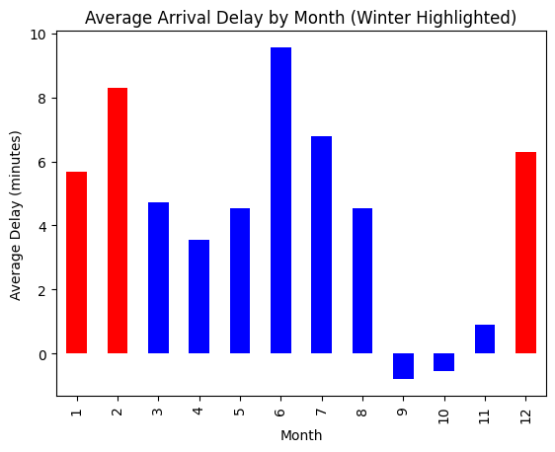
Seasonal Analysis (Winter)
Average winter delay: 6.71 minutes
Overall average delay: 4.45 minutes
Cancellation rate: ~3%

Slide 13

Key Insights
Weather is the major cause of cancellations
Winter season increases delays significantly
Busy airports experience more congestion and delays
Airline performance varies across carriers

Slide 14

Challenges
Handling large dataset efficiently
Managing missing values
Understanding complex delay patterns
Data preprocessing and cleaning

Slide 15

Future Scope
Build a flight delay prediction model
Develop a real-time dashboard
Use more recent and live data
Enhance analysis with machine learning

Slide 16
Conclusion
Cleaned and preprocessed large airline dataset
Engineered features like Month, Day, Hour, and Route
Analyzed delay patterns across airlines and time
Identified cancellation causes (weather, carrier, NAS)
Observed seasonal impact, especially winter delays
Explored airport traffic and congestion patterns

Slide 17
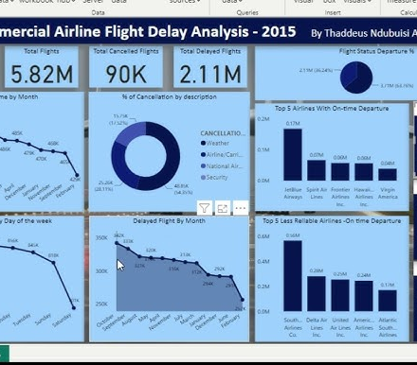



Thank you

